Slide 1

EE Project Presentation On College Predictor By M G SHAHBAZ JAHAN In partial fulfillment of requirements for the award of the degree Bachelor of Technology (Computer Science and Engineering) (2021) Under the guidance of Smt. Sri Devi Associate Professor Chaitanya Bharathi Institute of Technology

Slide 2
ABSTRACT This project Engineering Admission Predictor System is Python based application in which students can enter their rank and other details for prediction of the 10 best colleges for admission and can predict the accuracy of the result by analyzing the previous years data .The accuracy of the predictions increase as the more we use it. It is user friendly, fast, efficient and reliable .Using this software, a student can get a better idea about the colleges that he can join in.

Slide 3
ACKNOWLEDGEMENTS
I would like to express my special thanks of gratitude to my mentor Smt. Sri Devi associate professor as well as our principal who gave me the golden opportunity to do this wonderful project on the topic COLLEGE PREDICTOR, which also helped me in doing a lot of Research and i came to know about so many new things I am really thankful to them.

Slide 4
Problem Definition
Students face a lot of difficulties to secure an admission in the college of their choice. The current scenario of an engineering admission process is little complicated and not so easy in terms of selecting an appropriate college according to the scores and field of interest. Accurate choice, varying with the entrance exam result and academic scores, is very important to the candidates to fill in the application form. There are many colleges offering multiple engineering courses. So it becomes troublesome for students to organize and list-out the proper colleges of their choice for courses according to their performance score. This project consists of a smart list generator working together with the help of college predictor, to aid students in the admission process. The college admission predictor uses historical colleges cut-off students admission data for predicting the most probable colleges. The system analyzes student academic merits, background, and college admission criteria. Based on that, it predicts the likelihood of a university college that a student may enter. The smart list generator would enable the student to prepare the list of colleges, which could be needed to be filled in during the admission process. The system would also get feedback from the users, which would prove helpful for prediction evaluation and improving the performance factor.

Slide 5
Hardware Requirements
Number | Description
1 | PC with 250 GB or more Hard disk.
2 | PC with 2 GB RAM.
3 | PC with Pentium 1 and Above.
Software Requirements
Number | Description | Type
1 | Operating System | Windows XP / Windows
2 | Language | Python
3 | Files | Excel File, text flies
4 | IDE | IDLE, command prompt
5 | Modules | Tkinter, openpyxl

Slide 6
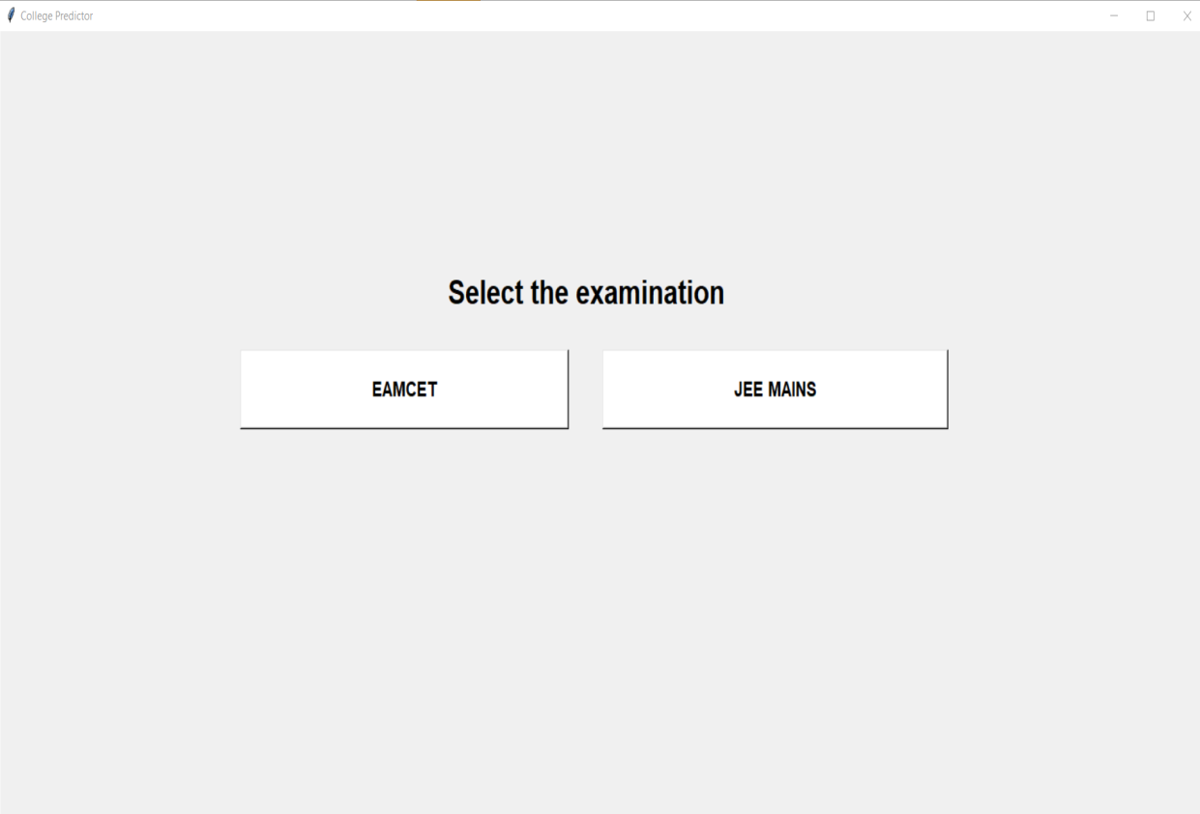

Slide 7
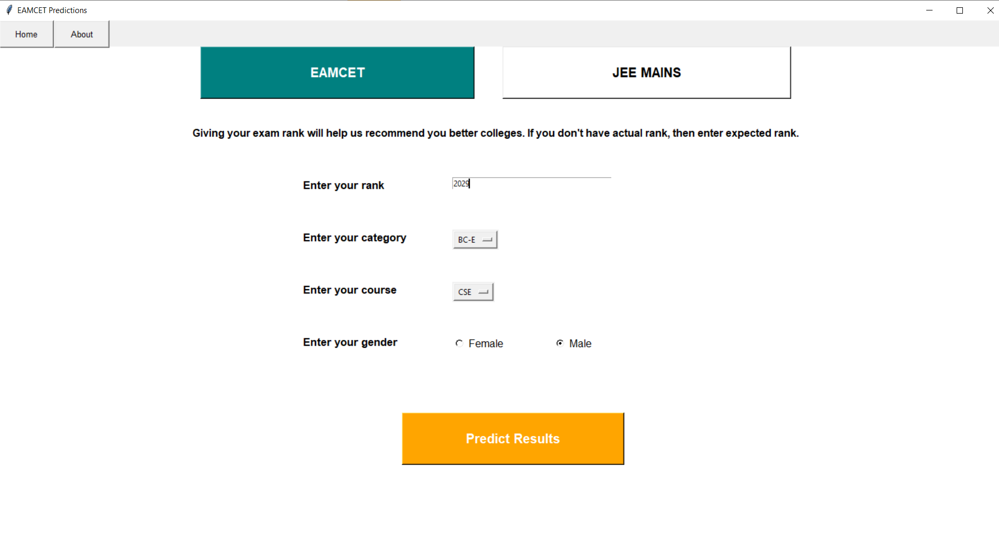

Slide 8
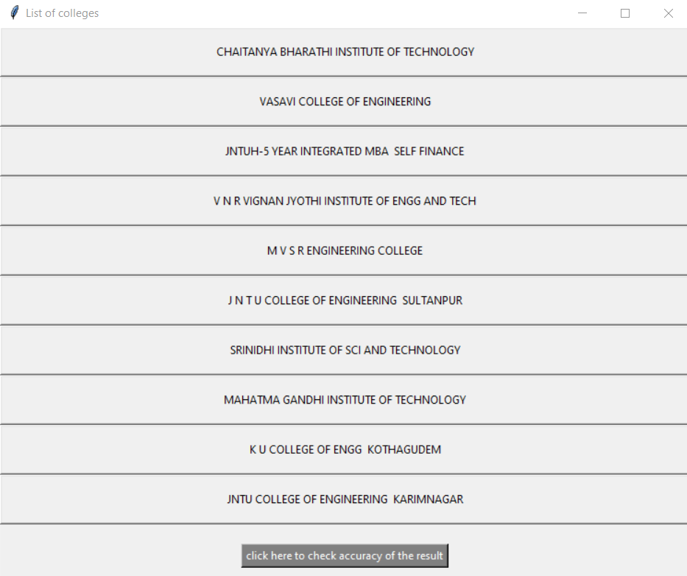

Slide 9
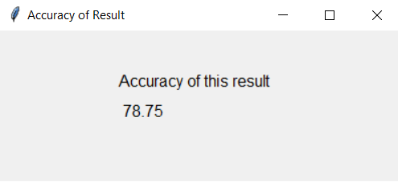

Slide 10
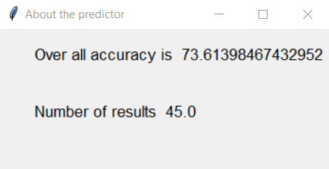

Slide 11
Methodology/Mechanism & Design:
This project is made possible using one of the object oriented programming language Python. Using classes in python the attributes are accessed in different methods to perform specific tasks. When the user runs the program a GUI appears and in the home page user is asked to select the examination the user wish to know about or to know the colleges that he can join if he tries to go with that examination. After user select an examination a new window appears in which the candidate is asked to enter the details regarding rank, gender, caste, special abilities and the courses in which candidate is interested to join in .After user enter all the details submit button is to be clicked. Now rank is confirmed to be a positive integer and if it fails the conditions a popup window appears saying error box saying invalid rank. If there are no colleges for the entered rank by the user a popup window pops saying the user couldn’t crack the exam. According to the information entered by the candidate, excel file is opened using the module Openpyxl, and a list of colleges and there cut offs for that particular category is selected based on the information entered by the user, all the colleges having cut offs greater than the rank of the candidate are added to a new list and new dictionary is created with the key being the rank and the value being the college name. This list is sorted and the least 10 cut offs are used as keys to call the values that are the college names are printed on the screen in a new window using the pack function. This list of colleges is the 10 best colleges that the user can try to join in.

Slide 12
The accuracy of the result is calculated based on similar operations carried on previous 3 years data. The final list of all four years data is compared to get the matching percentage of the result of the current year.
All the above steps are done in the GUI using tkinter.
The accuracy of the predictor is predicted by comparing the result of the current year with the previous three years list of colleges. The top 10 college list of all years is added to form a new list and then the list of current year is matched. If an element is repeated thrice that implies that the college has high probability of being a good possibility and contributes 4 out of 4. If an element is repeated twice then it contributes for 3 out of 4. If an element is repeated once then it contributes for 2 out of 4. If an element does not repeat then it contributes for 1 out of 4. Now the average of all the values are taken out and percentage is calculated. This percentage is been stored in a text file which help to show the overall accuracy of the predictor.

Slide 13
Future scope:
In future more exam results can be predicted by this predictor like the results of AP EAMCET, NEET, AIMS, POLYTECHNIC, GATE and many more along with the existing exams that are , JEE MAINS, JEE ADVANCED and TSEAMCET.
Furthermore improvement in UI is possible using place option instead of pack and grid and also by using better colour combinations.
The algorithm used for calculating accuracy of the predictor can be made more subtle so that we can get a better result accuracy which can furthermore improve the accuracy of the accuracy predictions.
Features like the details of the college in the result can be displayed using selenium module in python, which can help the user to get the college info easily without any extra effort so that comparing colleges becomes easier for the user.
Instead of using python by using html, css and javascript this can be made into a site that will enable the user to use this predictor from any place any time without having to install python and its modules and the files related to the data of the colleges and there cut offs.

Slide 14
References:
Codemy – tkinter course
[1]https://www.youtube.com/watch?v=YXPyB4XeYLA
Geeksforgeeks for widgets of tkinter
[2]https://www.geeksforgeeks.org/python-gui-tkinter/#:~:text=Out%20of%20all%20the%20GUI,tkinter%20is%20an%20easy%20task.
tutorialpoint for placing of the widgets
[3]https://www.tutorialspoint.com/python/python_gui_programming.htm
tseamcet cutoff data of previous 4 years data
[4]https://engineering.careers360.com/articles/ts-eamcet-cutoff
JEE cutoff data for 4 rounds
[5]https://engineering.careers360.com/articles/jee-main-cutoff-marks-and-ranks-faqs#:~:text=General%20Category%20%E2%80%93%2081%20to%20113,ST%20%E2%80%93%2027%20to%2048

